Slide 1
key logger and security
CAPSTONE PROJECT
Presented By:
GOMATHI.K-JKKN-CET-B.TECH-IT

Slide 2
OUTLINE
Problem Statement (Should not include solution)
Proposed System/Solution
System Development Approach (Technology Used)
Algorithm & Deployment
Result (Output Image)
Conclusion
Future Scope
References

Slide 3
Problem Statement
In today's digital age, where cybersecurity threats loom large, one of the significant concerns is the proliferation of keyloggers, stealthy software tools designed to monitor and record keystrokes on a user's computer without their knowledge. Keyloggers pose a severe threat to individuals and organizations as they can capture sensitive information such as passwords, credit card details, and other personal data, leading to identity theft, financial loss, and privacy breaches.

Slide 4
Proposed Solution
Keyloggers indeed pose significant threats in today's digital age. To protect yourself and your organization from keyloggers, consider implementing the following solutions:
Use Antivirus and Anti-Malware Software: Install reputable antivirus and anti-malware software on your computer systems and keep them up to date. These tools can detect and remove keyloggers and other malicious software.
Regularly Update Software: Keep your operating system, web browsers, and other software applications updated with the latest security patches. Software updates often include security fixes that address vulnerabilities that keyloggers can exploit.
Exercise Caution with Email and Downloads: Be cautious while opening email attachments or downloading files from the internet. Keyloggers can be disguised as legitimate files, so it's essential to verify the source and scan attachments with antivirus software before opening them.

Slide 5
Proposed Solution
Use a Firewall: Enable a reliable firewall on your computer or network to monitor and control incoming and outgoing network traffic. Firewalls can provide an additional layer of protection against unauthorized access and block suspicious connections.
Employ Two-Factor Authentication (2FA): Enable two-factor authentication whenever possible, especially for sensitive accounts such as email, banking, or social media. Two-factor authentication adds an extra layer of security by requiring a second form of verification, such as a unique code sent to your mobile device.
Be Wary of Phishing Attempts: Be vigilant against phishing attempts, where attackers try to trick you into revealing sensitive information. Avoid clicking on suspicious links or providing personal information in response to unsolicited emails, messages, or phone calls.

Slide 6
Proposed Solution
Regularly Monitor Accounts: Regularly review your bank statements, credit card bills, and other financial accounts for any unauthorized activity. If you notice any suspicious transactions, report them immediately.
Educate Yourself and Employees: Educate yourself and your employees about the risks of keyloggers and other cybersecurity threats. Promote safe online practices, such as using strong and unique passwords, avoiding suspicious websites, and being cautious with sharing personal information.
Consider Dedicated Anti-Keylogger Tools: There are specialized anti-keylogger tools available that can help detect and prevent keyloggers from capturing keystrokes. Research and consider using reputable anti-keylogger software that suits your needs.

Slide 7
System Approach
The "System Approach" section outlines the overall strategy and methodology for developing and implementing the rental bike prediction system. Here's a suggested structure for this section:
Risk Assessment
Security Policies and Procedures
Employee Education and Training
Access Control and Privileges
Endpoint Protection

Slide 8
Algorithm & Deployment
Algorithm:
Input: User's keystrokes and system events.
Initialize a keylogger detection module.
Start capturing keystrokes and system events.
Check for suspicious behavior or indicators of keylogger activity, such as abnormal keystroke patterns, unexpected system processes, or unauthorized network connections.
If suspicious behavior is detected, trigger an alert or take immediate action.
Analyze captured data to identify potential keyloggers and their sources.
Apply machine learning or pattern recognition techniques to improve keylogger detection accuracy over time.
Continuously monitor and log system events and network traffic for ongoing analysis and detection.
Implement countermeasures to prevent keyloggers from capturing sensitive information, such as virtual keyboards, encrypted data transmission, or behavior-based anomaly detection.
Regularly update the keylogger detection module with new signatures, algorithms, and heuristics to keep up with emerging keylogger variants.
Provide periodic reports and alerts to system administrators and users about detected keyloggers and actions taken.

Slide 9
Algorithm & Deployment
Deployment Plan:
Determine the scope: Identify the systems (workstations, servers, etc.) where the keylogger detection module will be deployed.
Integration with existing security infrastructure: Integrate the keylogger detection module with existing antivirus, firewall, and intrusion detection systems to leverage their capabilities and enhance overall security.
Develop the keylogger detection module: Design and develop the keylogger detection module, incorporating algorithms, heuristics, and machine learning techniques.
Test and validate: Conduct thorough testing and validation of the keylogger detection module in controlled environments to ensure accuracy and efficiency.
Deploy in a controlled environment: Deploy the keylogger detection module in a controlled environment, such as a test network or a limited number of systems, to monitor its performance and fine-tune the detection algorithms.
Gradual deployment: Implement a phased deployment approach, starting with critical systems and gradually expanding to cover the entire organization's infrastructure.
Regular updates and maintenance: Maintain the keylogger detection module by regularly updating it with new signatures, algorithms, and patches to address emerging threats.

Slide 10

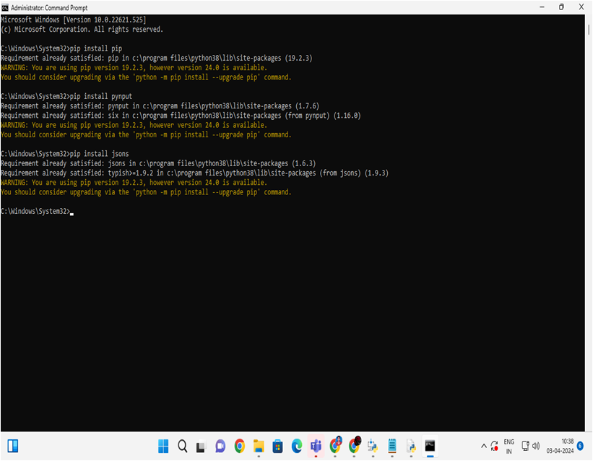
Algorithm & Deploy

Slide 11

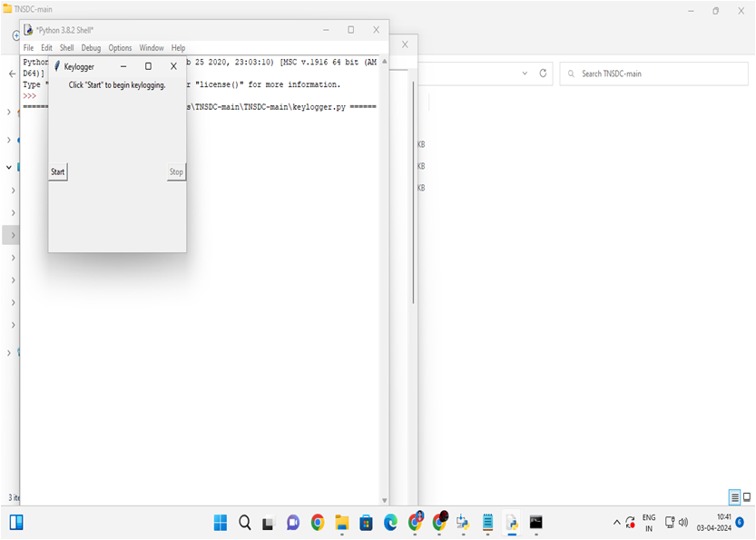
RESULT

Slide 12
Result
The implementation of comprehensive cybersecurity measures, including the deployment of keylogger detection modules and employee education, results in heightened protection against keyloggers, reduced risk of data breaches, and improved incident response capabilities.

Slide 13
Conclusion
In conclusion, by adopting a systematic approach that combines technical solutions, employee awareness, and continuous monitoring, organizations can effectively mitigate the threats posed by keyloggers and enhance their overall cybersecurity posture.

Slide 14
Future scope
In the future, advancements in artificial intelligence and machine learning can be leveraged to develop proactive and intelligent keylogger detection systems that can adapt to evolving threats and provide real-time protection against sophisticated keylogger attacks.

Slide 15
References
To address the keylogger problem, organizations should regularly update their security policies and practices by referring to reputable sources such as cybersecurity frameworks, industry best practices, and guidance from trusted organizations like NIST (National Institute of Standards and Technology) or CIS (Center for Internet Security).

Slide 16
References
To address the keylogger problem, organizations should regularly update their security policies and practices by referring to reputable sources such as cybersecurity frameworks, industry best practices, and guidance from trusted organizations like NIST (National Institute of Standards and Technology) or CIS (Center for Internet Security).

Slide 17
THANK YOU

